Slide 1
How to clone Git

Slide 2

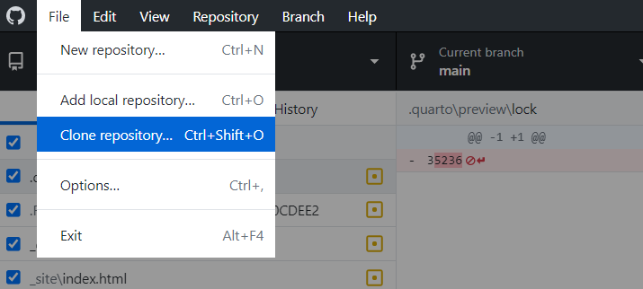
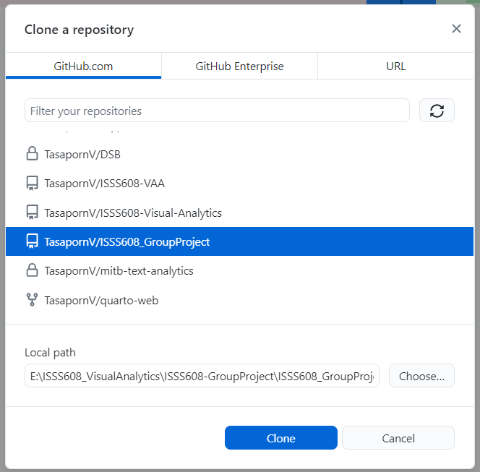
1. Install Git Desktop
2. Go to file -> Select Clone repository
3. Select the repository that you want to clone to your local path
4. Select the proper local path
5. Click Clone

Slide 3
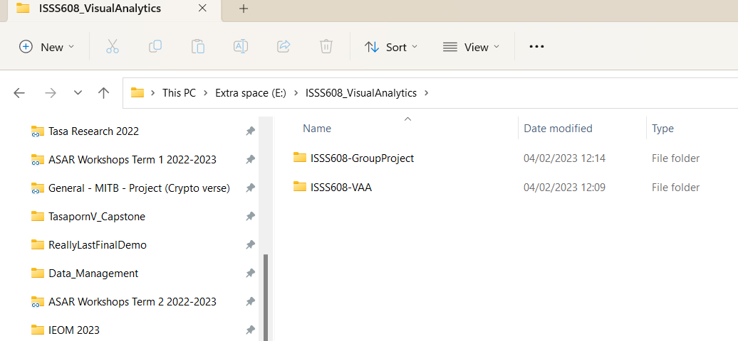
Once you successfully clone, open the folder directory in your local computer. You should see the folder from git repository generated there.

Slide 4
How to update on Git

Slide 5
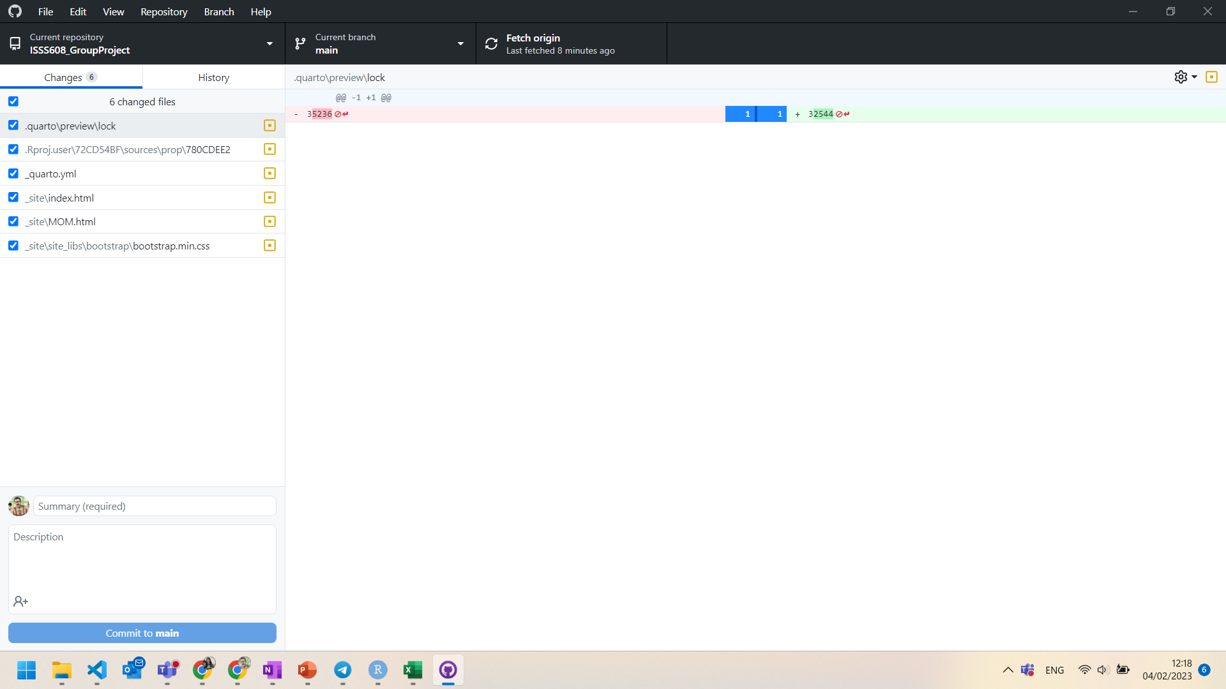
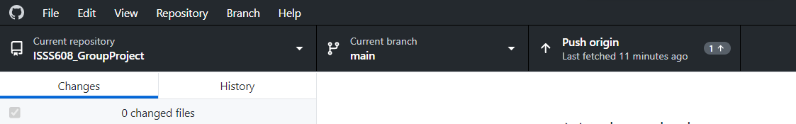
1. Ensure that you are on the correct repository
2. Always fetch origin before you start working to ensure that you will be working on the latest version
3. Any changes that you’ve made will reflect here automatically
4. Type the summary of what change you have done in this update and click commit
5. Once you commit, this will change to “push origin”. Click push origin

Slide 6
How to work on Rstudio files

Slide 7
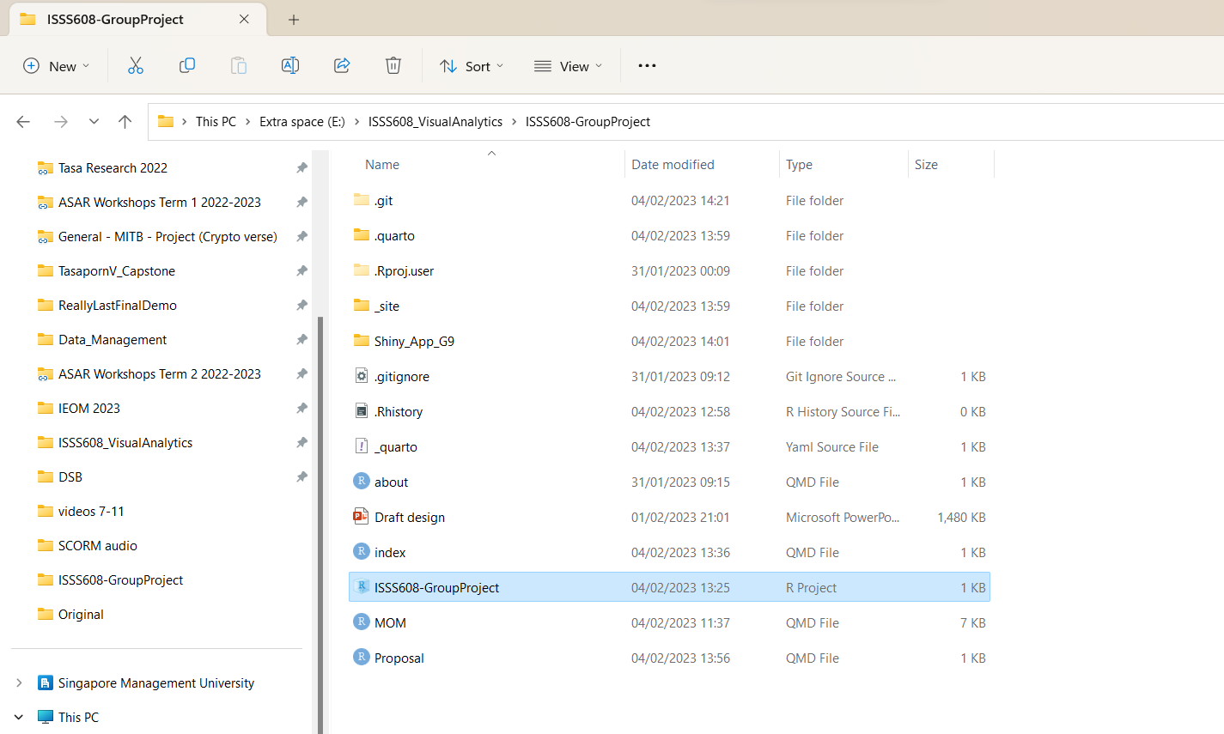
Remember, always start working by opening the project file.

Slide 8
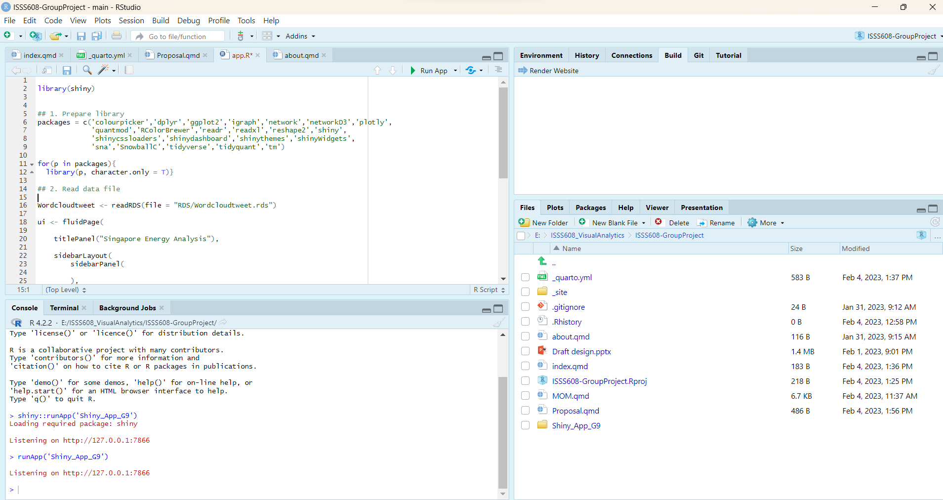
By opening the project file, it will automatically create an environment and set the directory to be relative with the project we are working on.

